Slide 1
Electric Blind​
Group 13
Ryan Meinke (Computer Engineering)
Joshua Forrest (Electrical Engineering)
Tien Tran (Electrical Engineering)
Adedoyin Adepegba (Computer and Electrical Engineering)

Slide 2
Project Motivation​
Create a cost-efficient and energy saving product
Automated blinds on the market presently do not allow multiple activation methods
Current automated blinds do not also give high energy efficiency
Create a low-cost, energy efficient electric blind that:
  Can be activated using multiple activation methods

Slide 3
Goals and Objectives​
Cheap electric blind
Low activation time
Low power consumption
Multiple activation methods for automating the process of interacting with a window
  Switch
  Human presence
  Digital Application
​

Slide 4
Requirement Specifications​
​

Slide 5
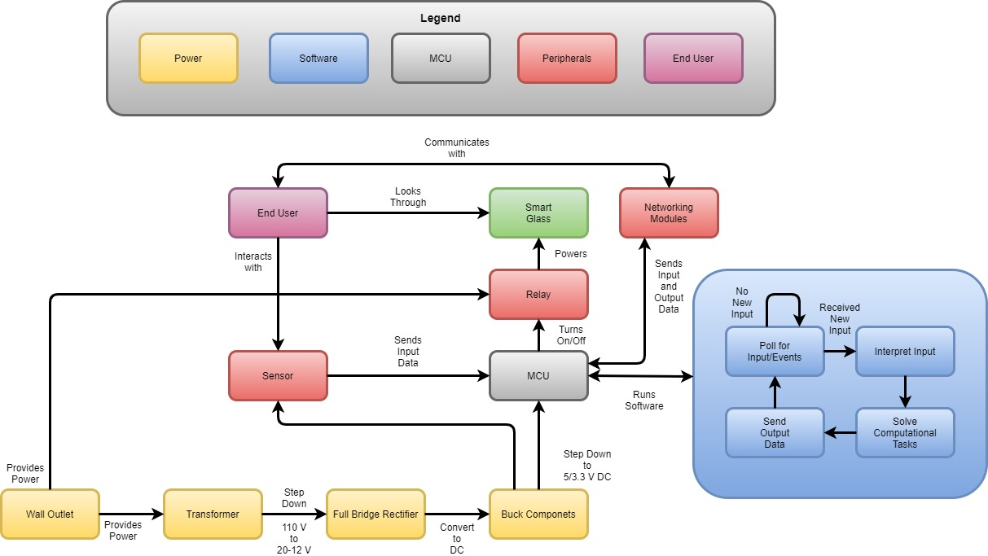
Overall Block Diagram

Slide 6
Hardware

Slide 7
Power Design
Components | Operating Voltage (V) | Operating Current (mA) | Power Consumption (W)
PIR sensor | 5 | 32 | 0.160
MCU | 3.3 | 80 | 0.264
PDLC Film | 30 | 12.4 | 0.372
Relay (Dissipation power) |  |  | 1.350
Transformer | 12 | 500 | 6
Total Power Consumption |  |  | 8.146

Slide 8
Proximity Sensing Technology
Inductive Proximity Sensor
Capacitive Proximity Sensor
Magnetic Proximity Sensor
Ultrasonic Proximity Sensor
Photoelectric Proximity Sensor
    Thru-Beam Mode
    Retroreflective Mode
    Diffused Mode

Slide 9
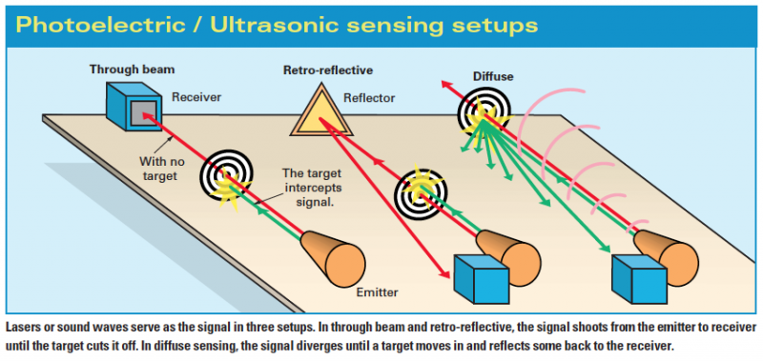
Different Modes for Photoelectric Proximity Sensing Technology

Slide 10
MCM 287-18001 PIR Sensor
Specifications | Value
Input voltage | 5-20 V
Power Consumption | 32 mA
Output voltage | High: 3.3 V Low: 0V
Sensing Range | 7 m
Angle | < 110 degree Cone Anglee
Repeatable Mode | Y
Range Adjustment | Y

Slide 11
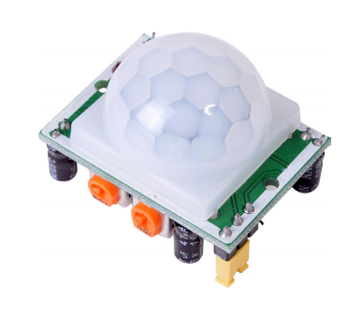
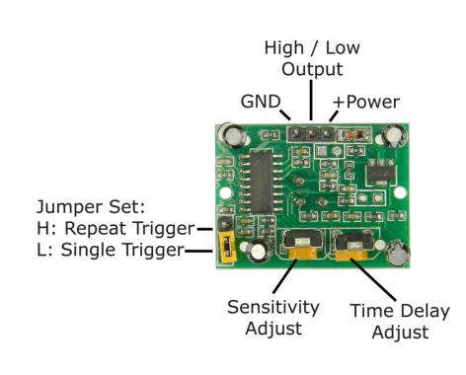
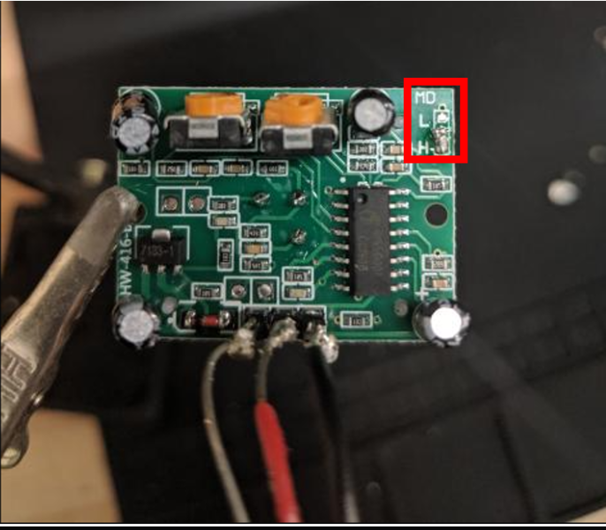
PIR Proximity Sensor

Slide 12
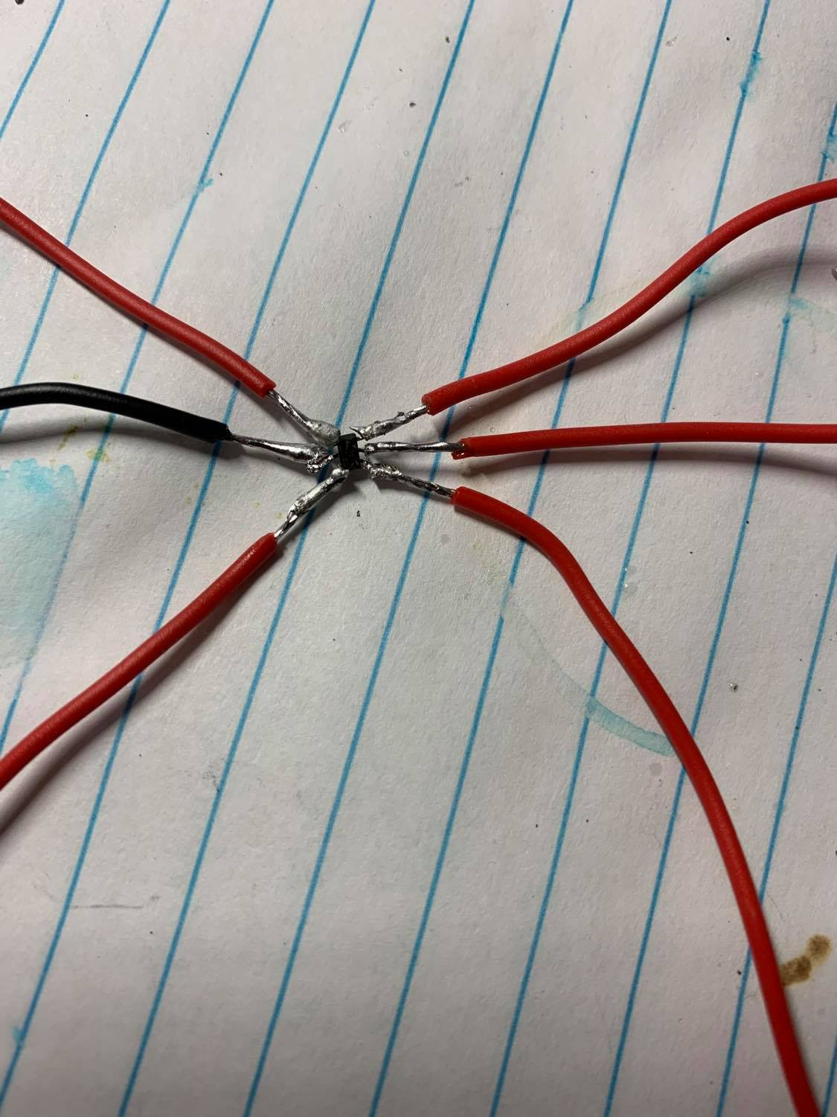
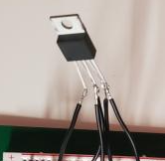
Voltage Regulator
 | XRP7659 | LM2575-ADJ
Input Range | 4.5 V – 18 V | 1.2 V – 37 V
Output Voltage | 3.3, 5, 12 V | 3.3, 5, 12 V
Output Current | 1.5 A | 1 A
Efficiency | Up to 92 % | 87.5 %
Operating Switching Frequency | 1.4 MHz | 52 kHz
Cost | $ 0.8 | $ 3.70
Dimension | 2.82 x 2.65 x 1.45 mm (with distance between 2 pins is 0.95 mm) | 10.67 x 4.83 x 30.84 mm (with distance between 2 pins is 1.7 mm)

Slide 13
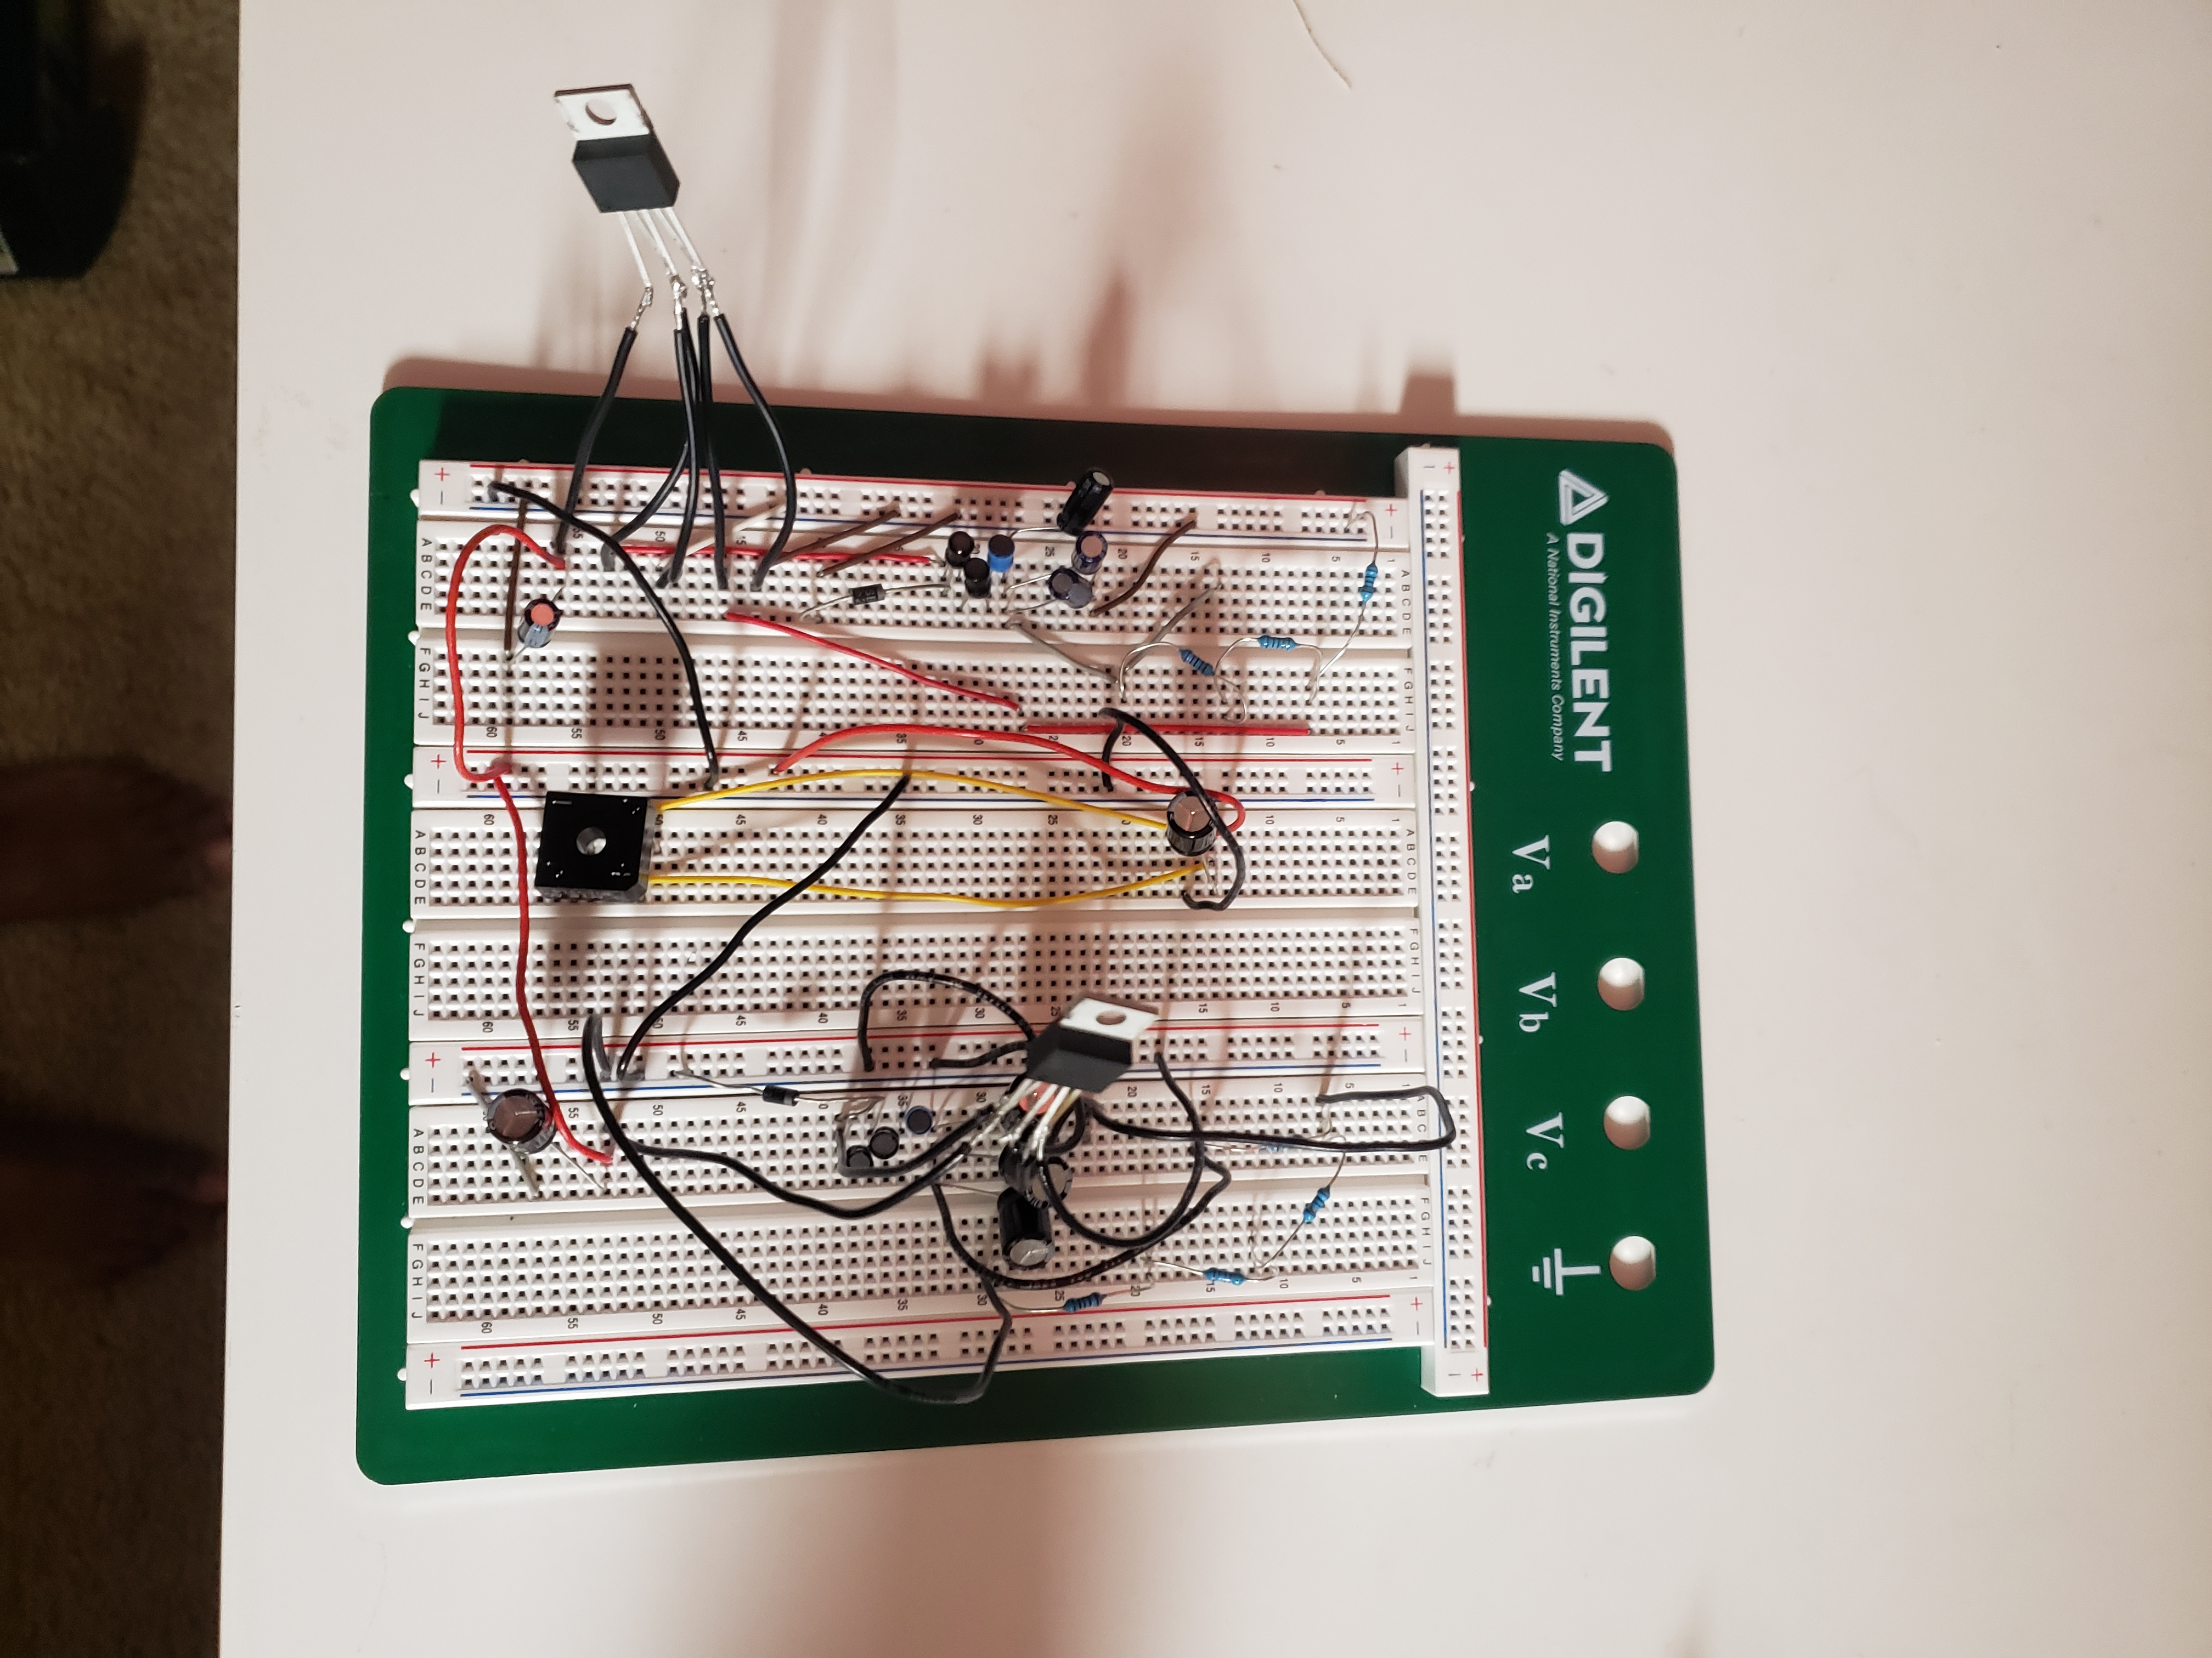
Testing Circuit

Slide 14
Software​

Slide 15
Software Core Functionalities​
Control Smart Glass​
Manage Input and Output​

Slide 16
Control Smart Glass Functionality​
Simple​
Send signal to relay​
Binary Choice​
Send the signal​
Don't send the signal​
​
​

Slide 17
Manage Input/Output Functionality​
A bit more complicated​
Multiple Types on Input/Output​
Sensors​
Network​
​

Slide 18
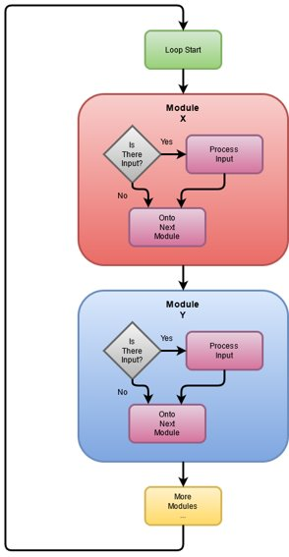
Software Diagram​

Slide 19
Modularization​
Configurability​
Continual Feature Development​
Permissions​
​

Slide 20
Proximity Sensor Input​
Check sensor value​
Set Glass State Accordingly​
​

Slide 21
IPv4 Network Input​
Listen on IP address/port combination for new packet​
Parse packet in accordance with custom protocol​
Process any work needed​
Send custom protocol compliant response packet​
​

Slide 22
Custom Protocol​
What's the need?​
Computer Networks are imperfect​
Reliability vs Speed​
Modularization Standard​
Will likely make changes during testing​
​

Slide 23
Code Quality Controls​
What's the need?​
Version Control​
git​
Code Linting​
Style Guideline​
Documentation​
Comments​
Markdown docs​
Rigorous Code Review​

Slide 24
Work Completed vs Work Remaining​
Need to run code​
One of the last things to be completed​
Work Completed​
Overall Code Design​
Code Proof of Concepts​
"untested" Code​
Work Remaining​
Finish Development​
Rigorous Testing / Software Corrections as Needed​
Documentation​
Additional Features Development​

Slide 25
Arduino​
Well Established Standard​
Abstraction​

Slide 26
Microcontroller Unit

Slide 27
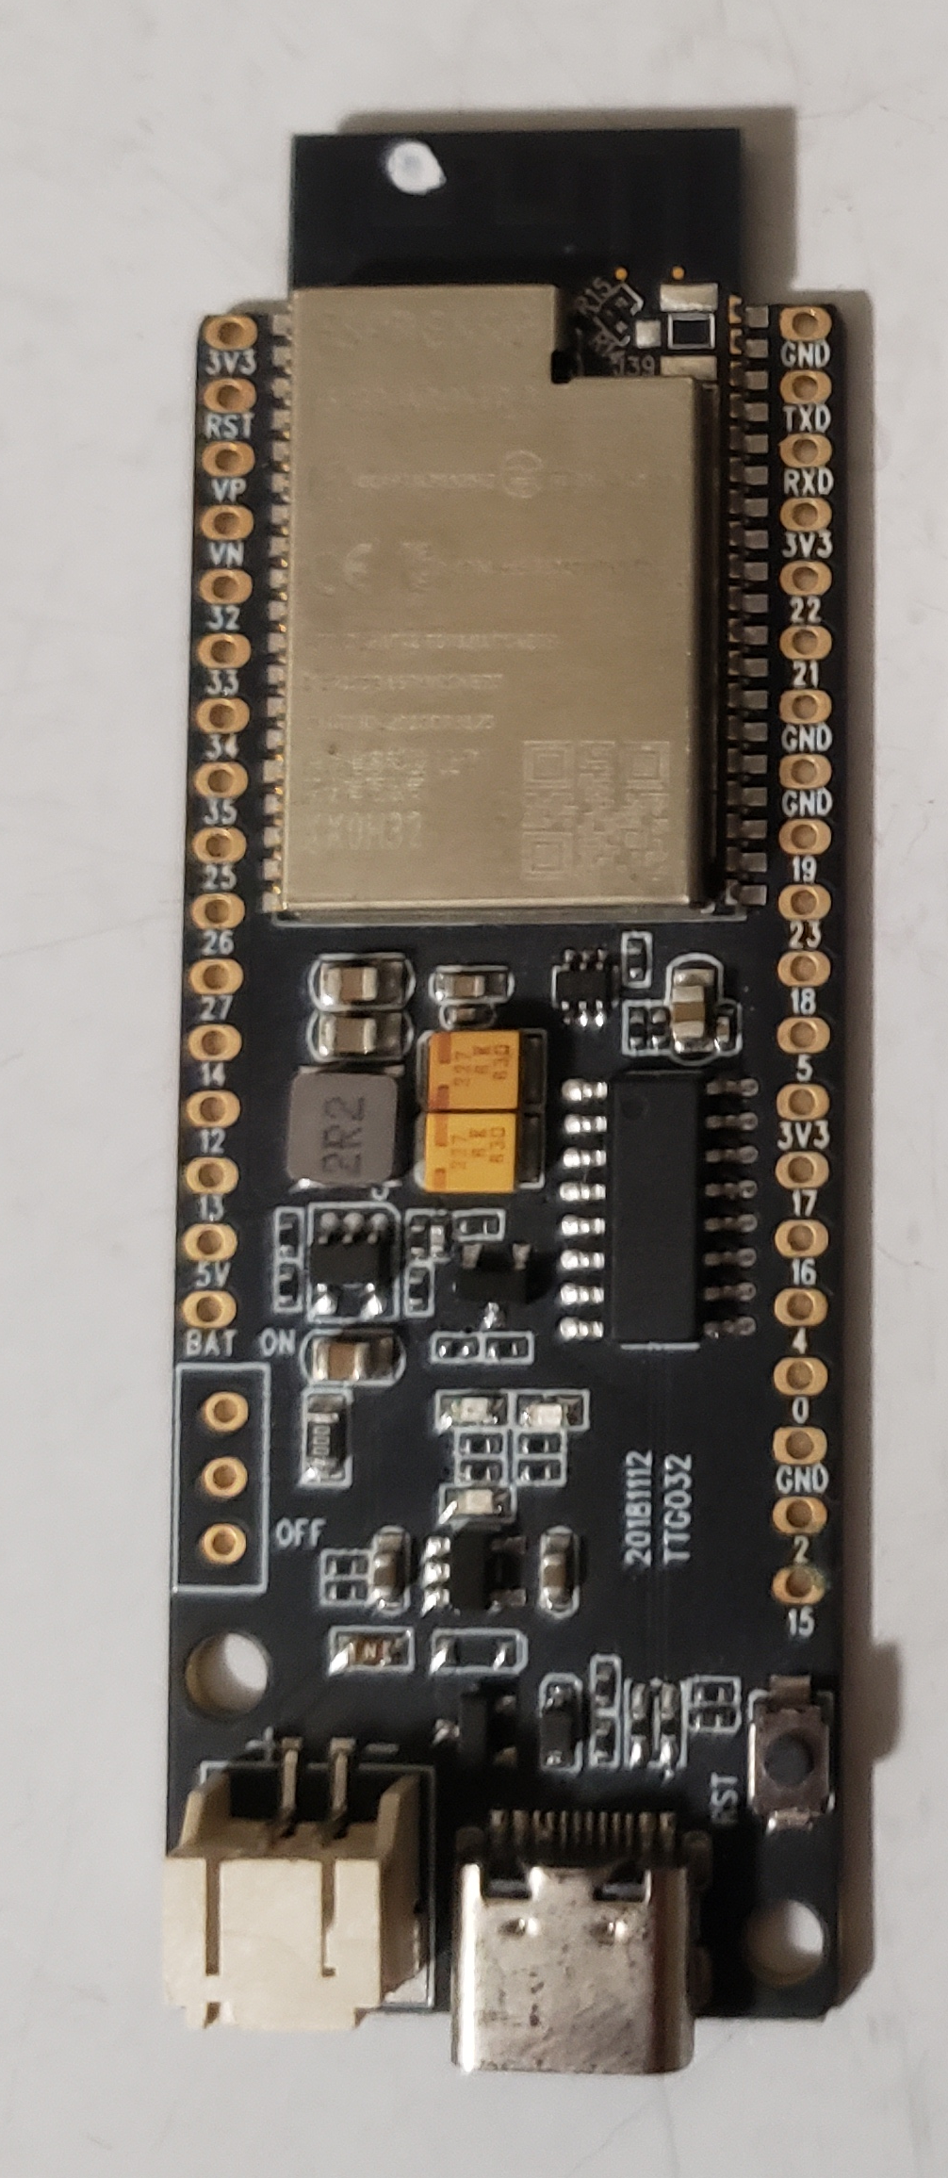
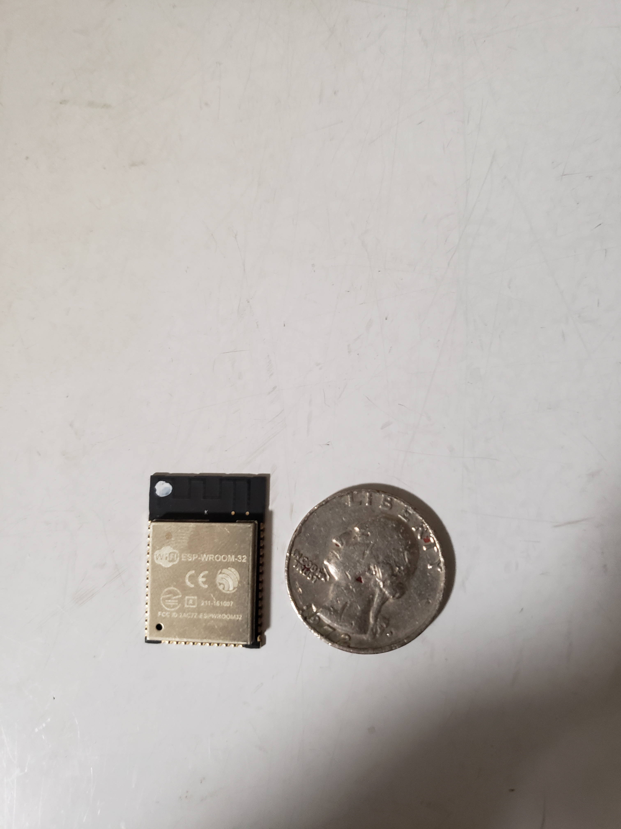
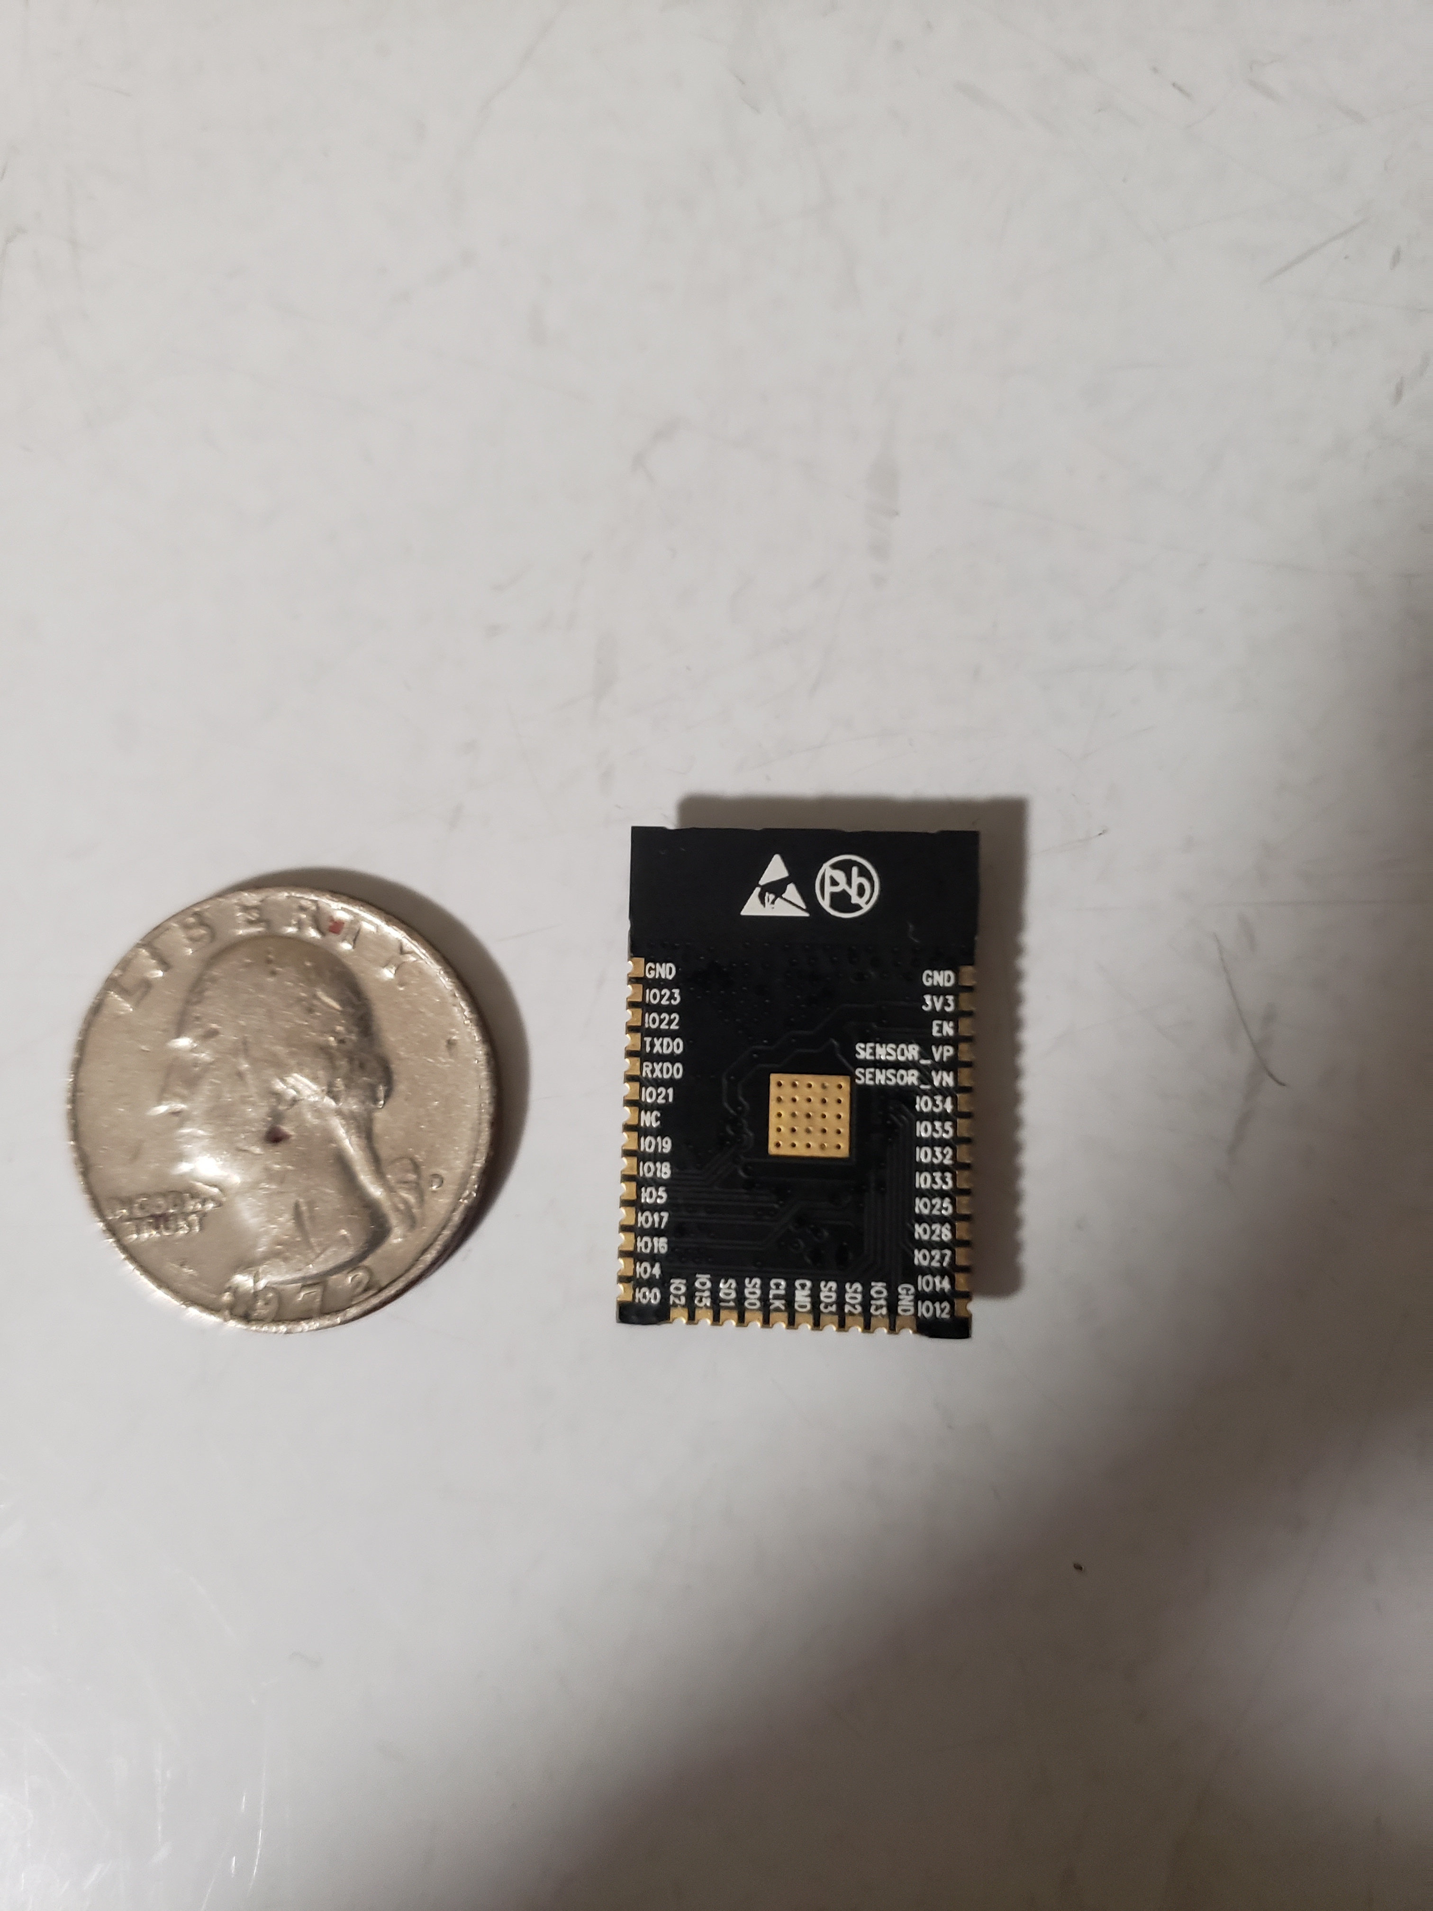
MCU Choice – ESP32​
​ESP32-WROOM on ESP32 Koala Development Board
  Dual-core CPU
  Operating voltage/Power Supply of 3.0 – 3.6V
  Operating current ~ 80mA
  4Mb flash

Slide 28
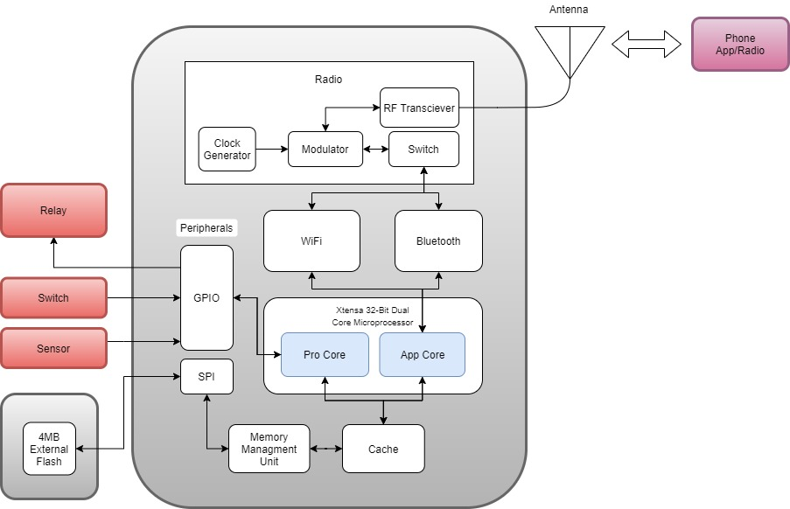
Inner workings of the MCU​

Slide 29
Administrative Content​

Slide 30

Work Distribution​
Team Members | Hardware | Software | MCU
Ryan Meinke
Tien Tran
Joshua Forrest
Adedoyin Adepegba

Slide 31
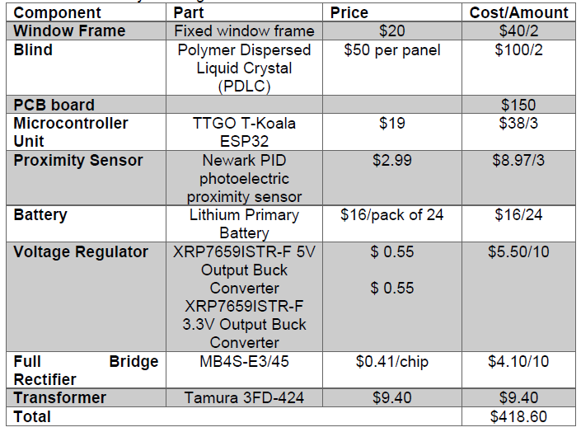
Budget​

Slide 32
Work Progress​

Slide 33
Questions???

